Slide 1


Slide 2
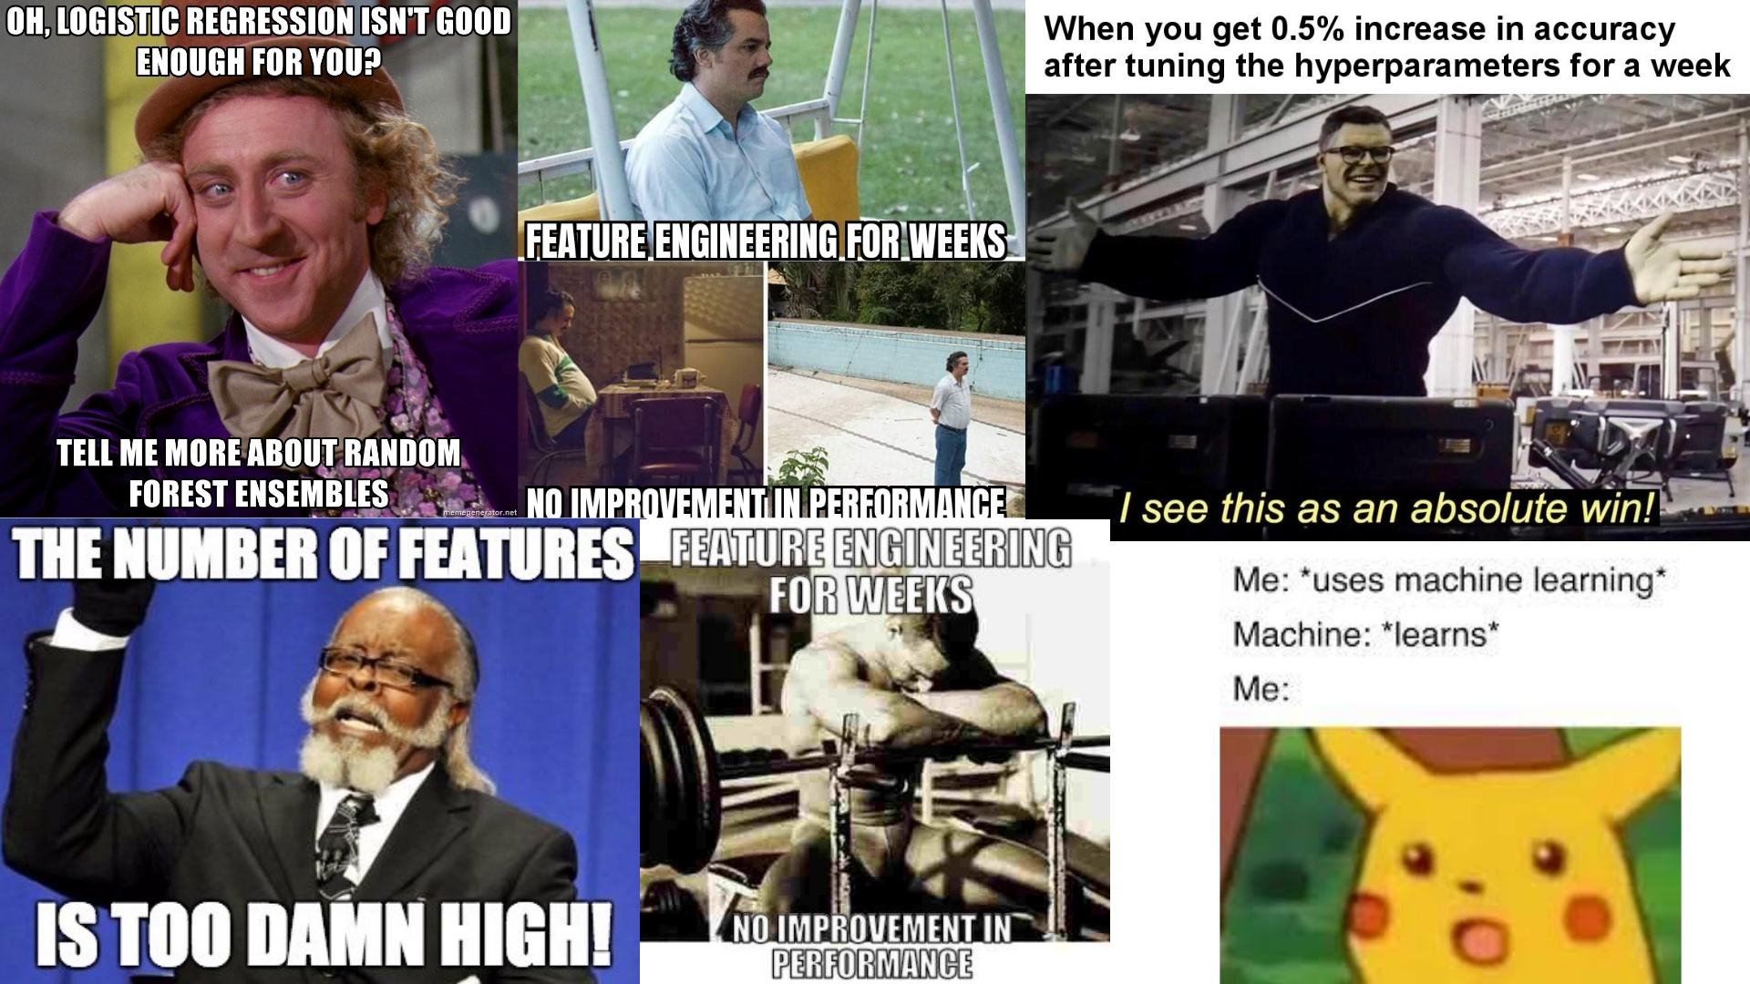

Slide 3
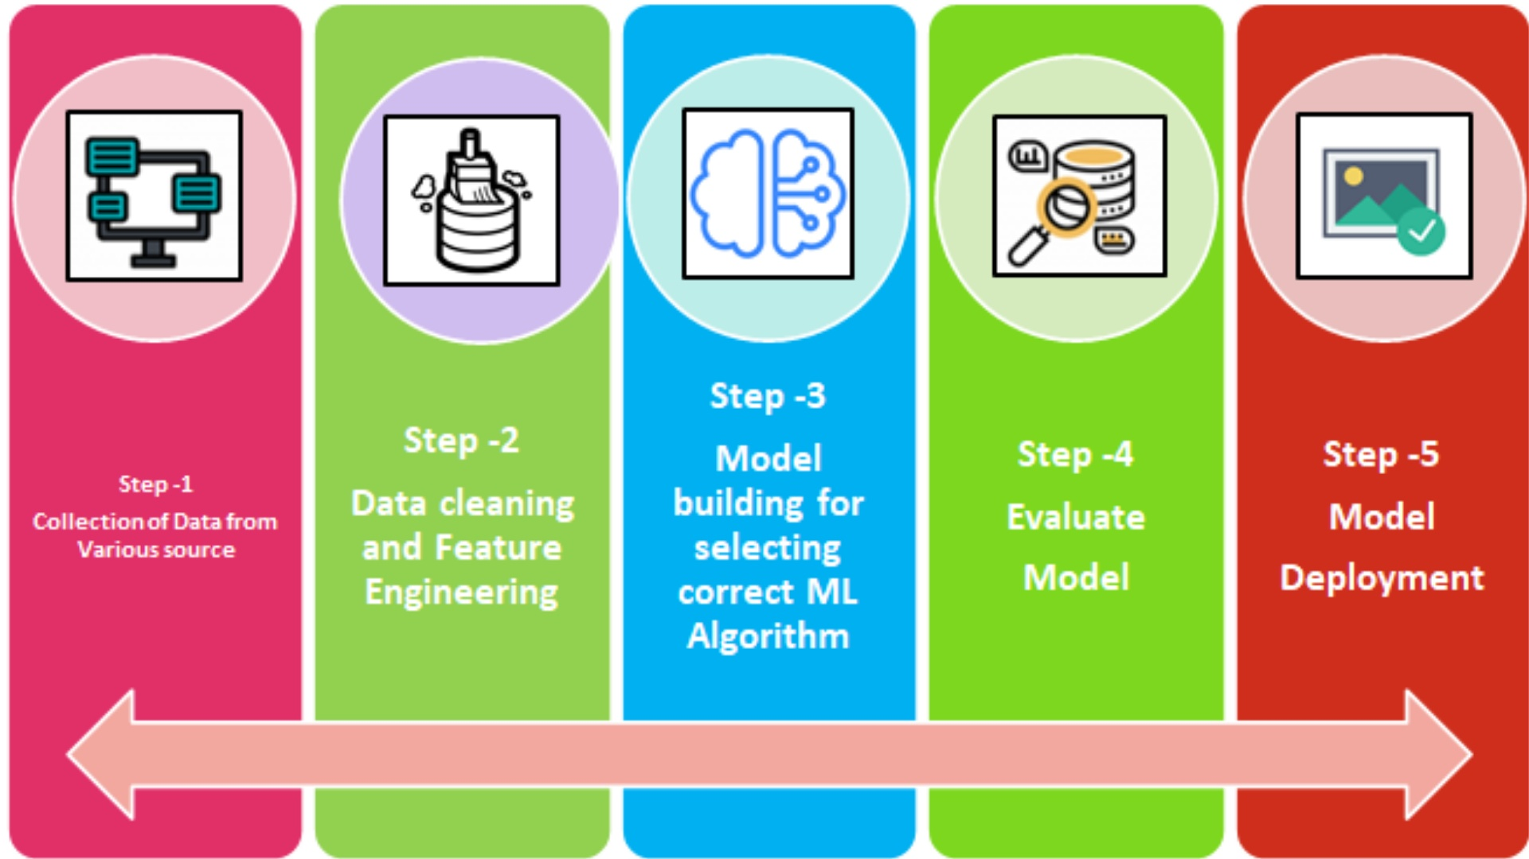
Notes:
Before we get into our problem I want use to understand the bigger picture. These 5 steps are the steps done when building a machine learning model. For now, we have mostly focused on step 3 by talking about many ML algorithms, however, from this point onwards we are going to also focus on other areas as they are also of great importance. Today, we will focus on step 2, data cleaning and feature engineering, while also teaching you a new model called XGBoost.

Slide 4

Notes:
Data cleansing is the process of modifying your data to improve the accuracy of your model by a few % points This means taking care of missing values removing duplicates removing outliers in order to increase the quality and accuracy of your dataset.

Slide 5
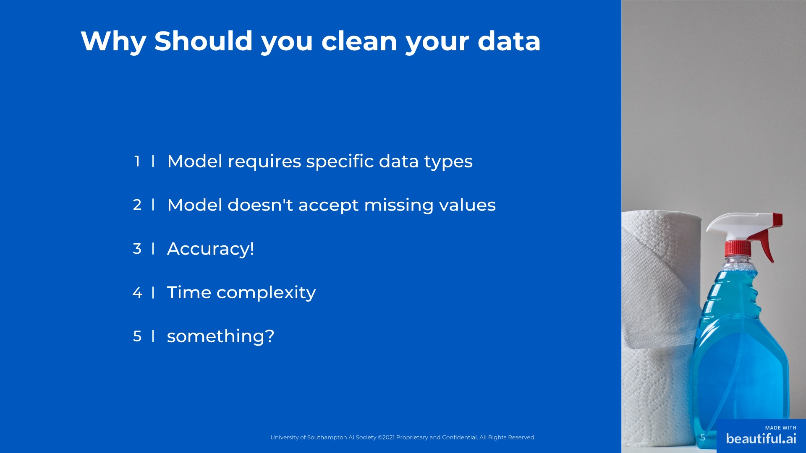
Notes:
1. Sometimes the data type you're trying to process will not be computable by a model i.e. text being processed by an algorithm (more on that later) so you have to modify it structurally. 2. Missing values, nans (not a number s), 0, and whitespace characters all break the model. You want to watch out for those 3. Accuracy is affected by data cleansing - as we shall see, your model can make closer predictions by manipulating the data 4. Sometimes having too many features or observations means you must run the code for DAYS. You can avoid that with data cleansing 5.

Slide 6
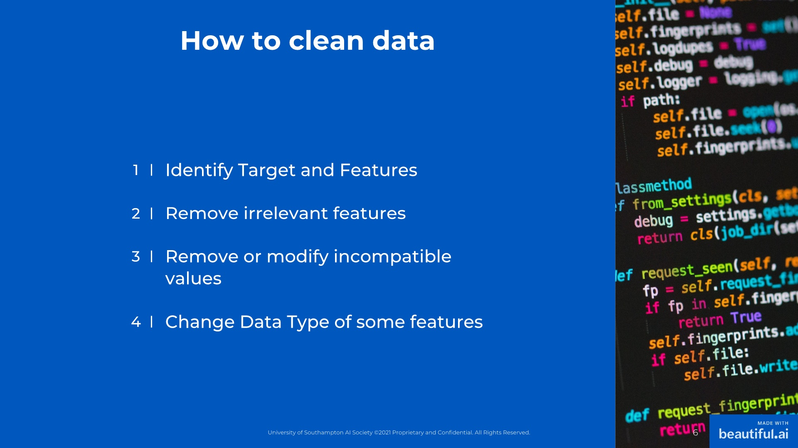
Notes:
1. Sometimes the data type you're trying to process will not be computable by a model i.e. text being processed by an algorithm (more on that later) so you have to modify it structurally. 2. Missing values, nans (not a number s), 0, and whitespace characters all break the model. You want to watch out for those 3. Accuracy is affected by data cleansing - as we shall see, your model can make closer predictions by manipulating the data 4. Sometimes having too many features or observations means you must run the code for DAYS. You can avoid that with data cleansing 5.

Slide 7
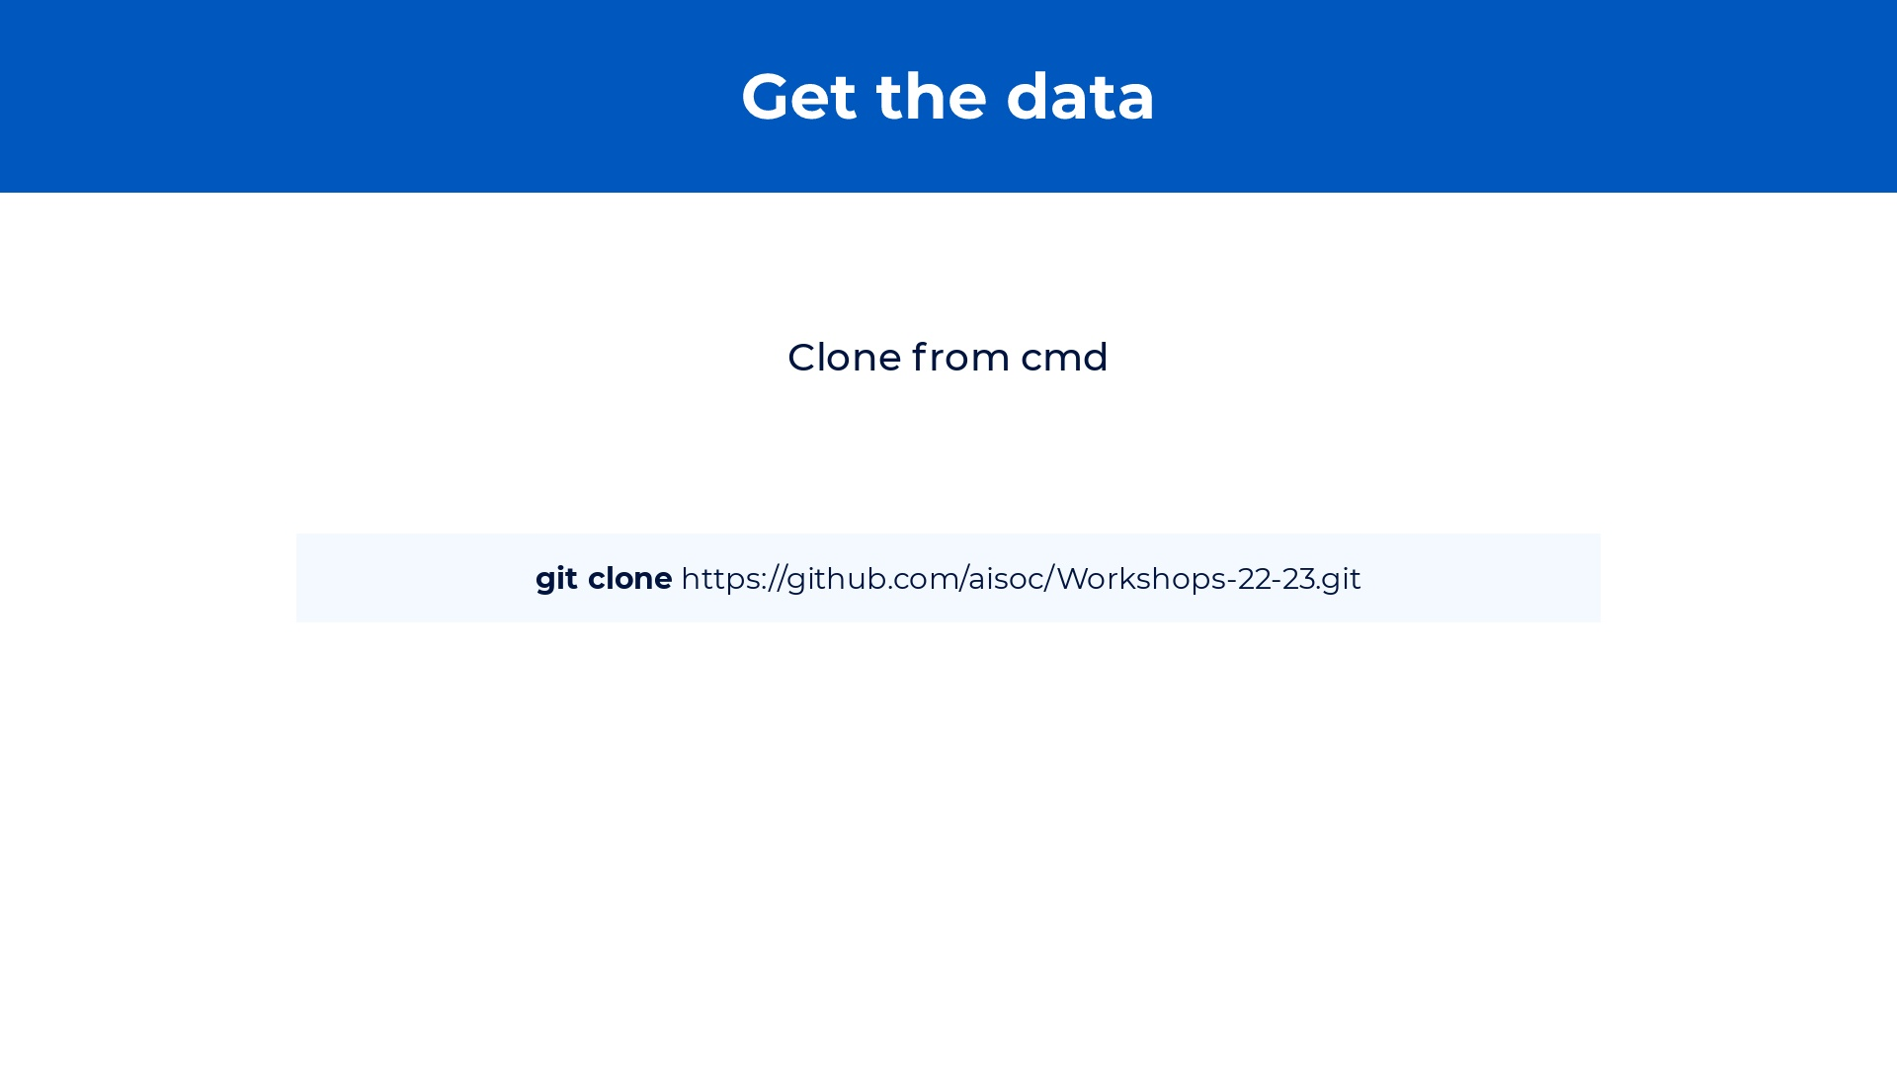
Notes:
Let's begin by talking about what Data Cleansing and Feature engineering is and why it is important. Data cleansing is the process of cleaning your data. This means taking care of missing values, removing duplicates, and removing outliers in order to increase the quality and accuracy of your dataset. We will be showing some methods of data cleansing today but really recommend you having a further read as there are many techniques you could use. Feature engineering is the process of selecting, manipulating and transforming data into feature that can be used in supervised learning. So with feature engineering, we can change the type of values [show example] so that it matches our models requirements. We can also create new features based on data we current have [show example], and we can do some exploratory data analysis where we explore the patterns in our dataset [show example]. Feature engineering is very important as without it the model wouldn't work. Furthermore, it is the area in which ML engineers spend most time in the entire ML process because it can highly improve the model quality and can be quite complex depending on your dataset. I have provided a list of tools that you can use to facilitate your feature engineering. I really recommend exploring these tools and techniques as there are so many that can really improve your model while making your life easier. In future workshops we'll always try to solve the problem with new data cleansing and feature engineering techniques, just like we do with models, so you can familiarize yourself with them. https://monkeylearn.com/blog/data-cleaning-python/ https://towardsdatascience.com/what-is-feature-engineering-importance-tools-and-techniques-for-machine-learning-2080b0269f10 note-to-self: last sentence is very important. In beginning of year maybe we should give a pandas tutorial, and focus on one area per workshop but then second half we combine everything and start teaching models and techniques based on problems. Website should have articles on every major model and technique. Focus on real life significance.

Slide 8
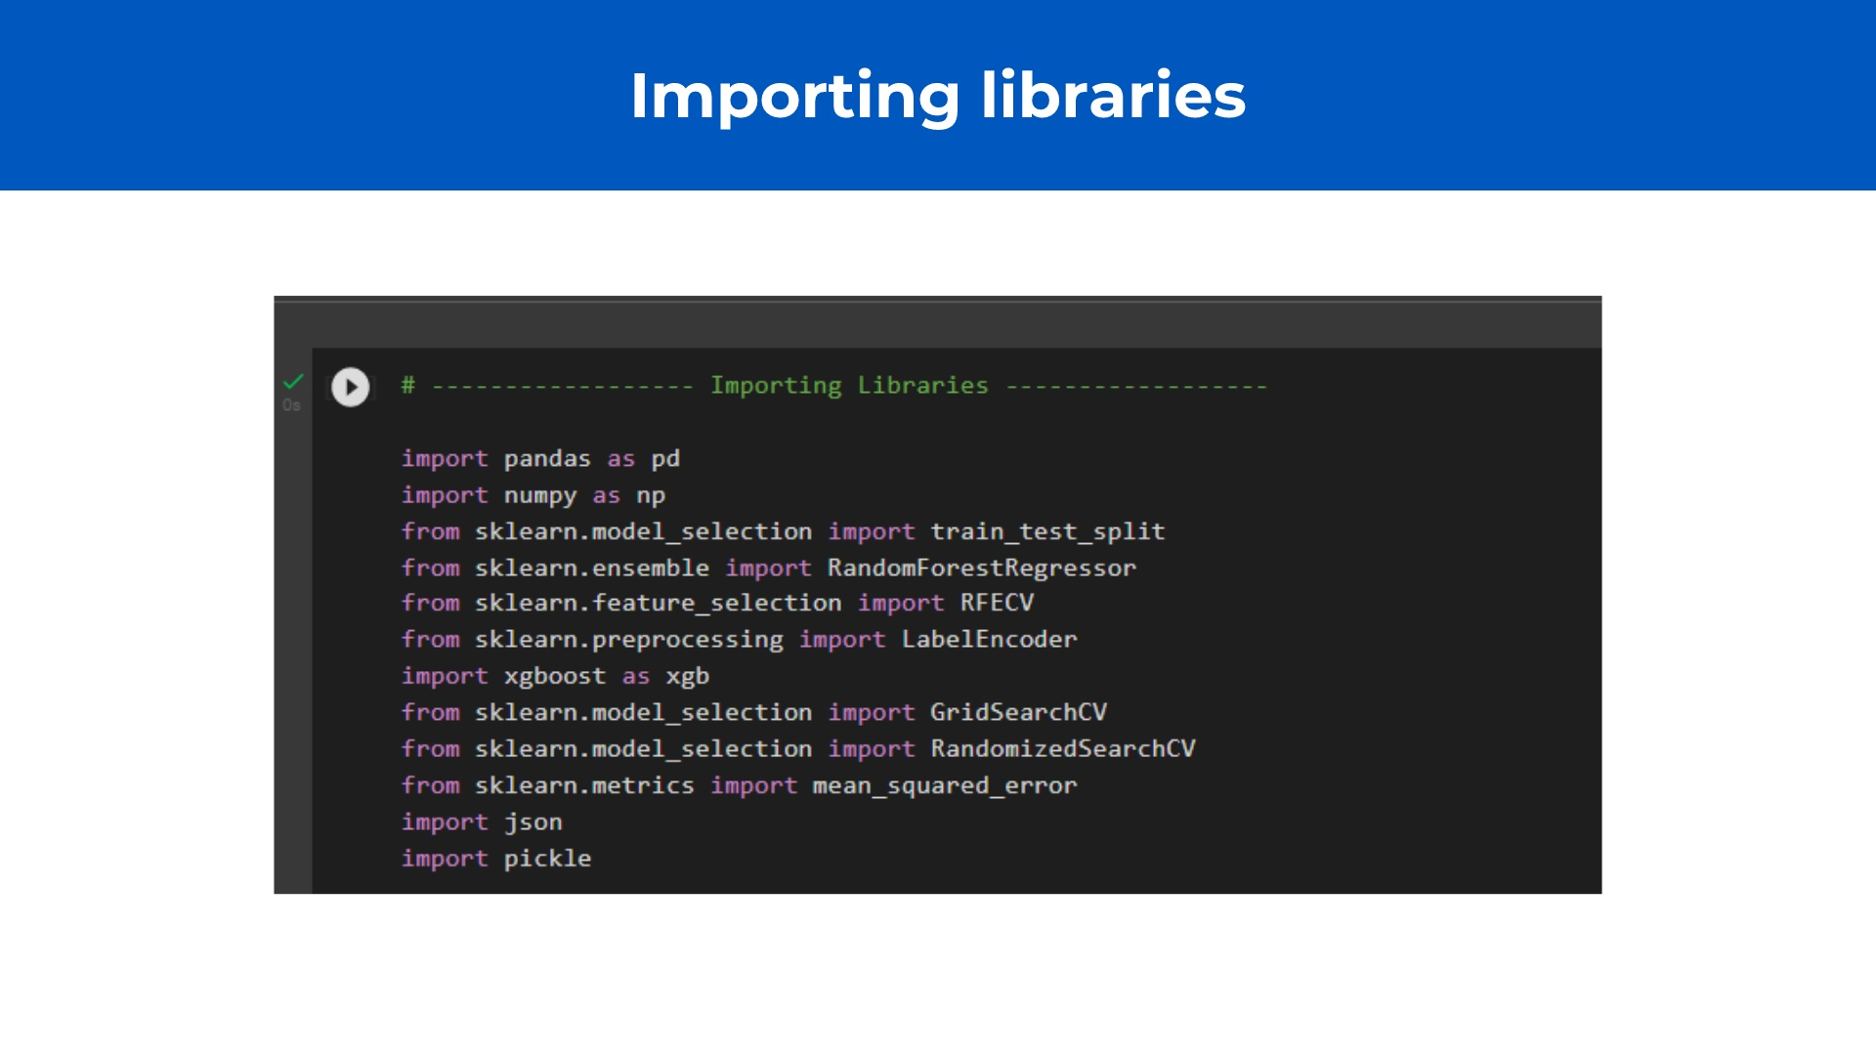
Notes:
Let's begin by talking about what Data Cleansing and Feature engineering is and why it is important. Data cleansing is the process of cleaning your data. This means taking care of missing values, removing duplicates, and removing outliers in order to increase the quality and accuracy of your dataset. We will be showing some methods of data cleansing today but really recommend you having a further read as there are many techniques you could use. Feature engineering is the process of selecting, manipulating and transforming data into feature that can be used in supervised learning. So with feature engineering, we can change the type of values [show example] so that it matches our models requirements. We can also create new features based on data we current have [show example], and we can do some exploratory data analysis where we explore the patterns in our dataset [show example]. Feature engineering is very important as without it the model wouldn't work. Furthermore, it is the area in which ML engineers spend most time in the entire ML process because it can highly improve the model quality and can be quite complex depending on your dataset. I have provided a list of tools that you can use to facilitate your feature engineering. I really recommend exploring these tools and techniques as there are so many that can really improve your model while making your life easier. In future workshops we'll always try to solve the problem with new data cleansing and feature engineering techniques, just like we do with models, so you can familiarize yourself with them. https://monkeylearn.com/blog/data-cleaning-python/ https://towardsdatascience.com/what-is-feature-engineering-importance-tools-and-techniques-for-machine-learning-2080b0269f10 note-to-self: last sentence is very important. In beginning of year maybe we should give a pandas tutorial, and focus on one area per workshop but then second half we combine everything and start teaching models and techniques based on problems. Website should have articles on every major model and technique. Focus on real life significance.

Slide 9
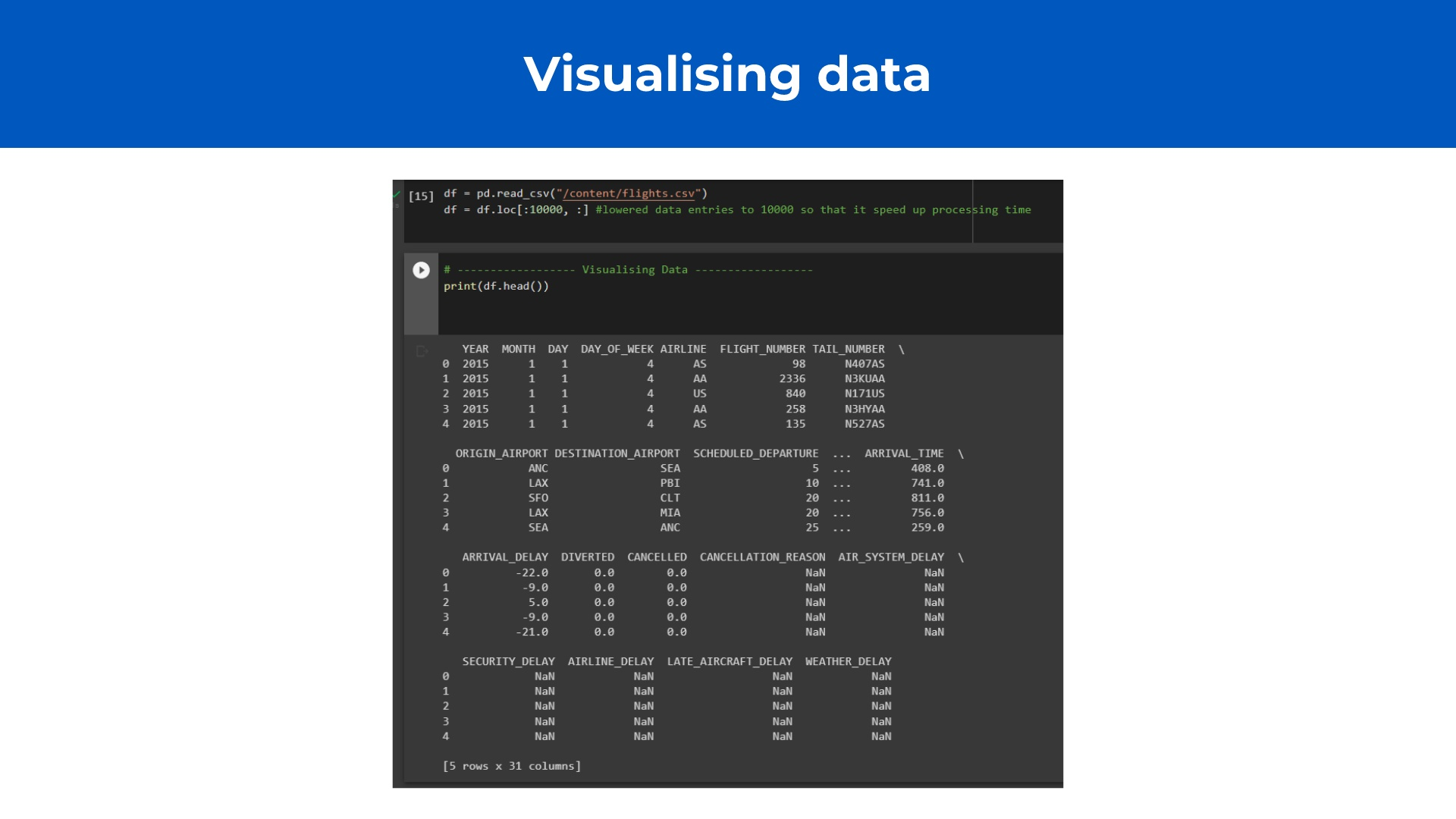
Notes:
Read the dataset (mention you have to import it) Some values are not interesting All the NaNs are reasons or conditions for delay. But they do not affect the delay itself. We also know them after the delay Locate that Arrival delay is the Target (Note that it is negative as well) Encode features and variable

Slide 10
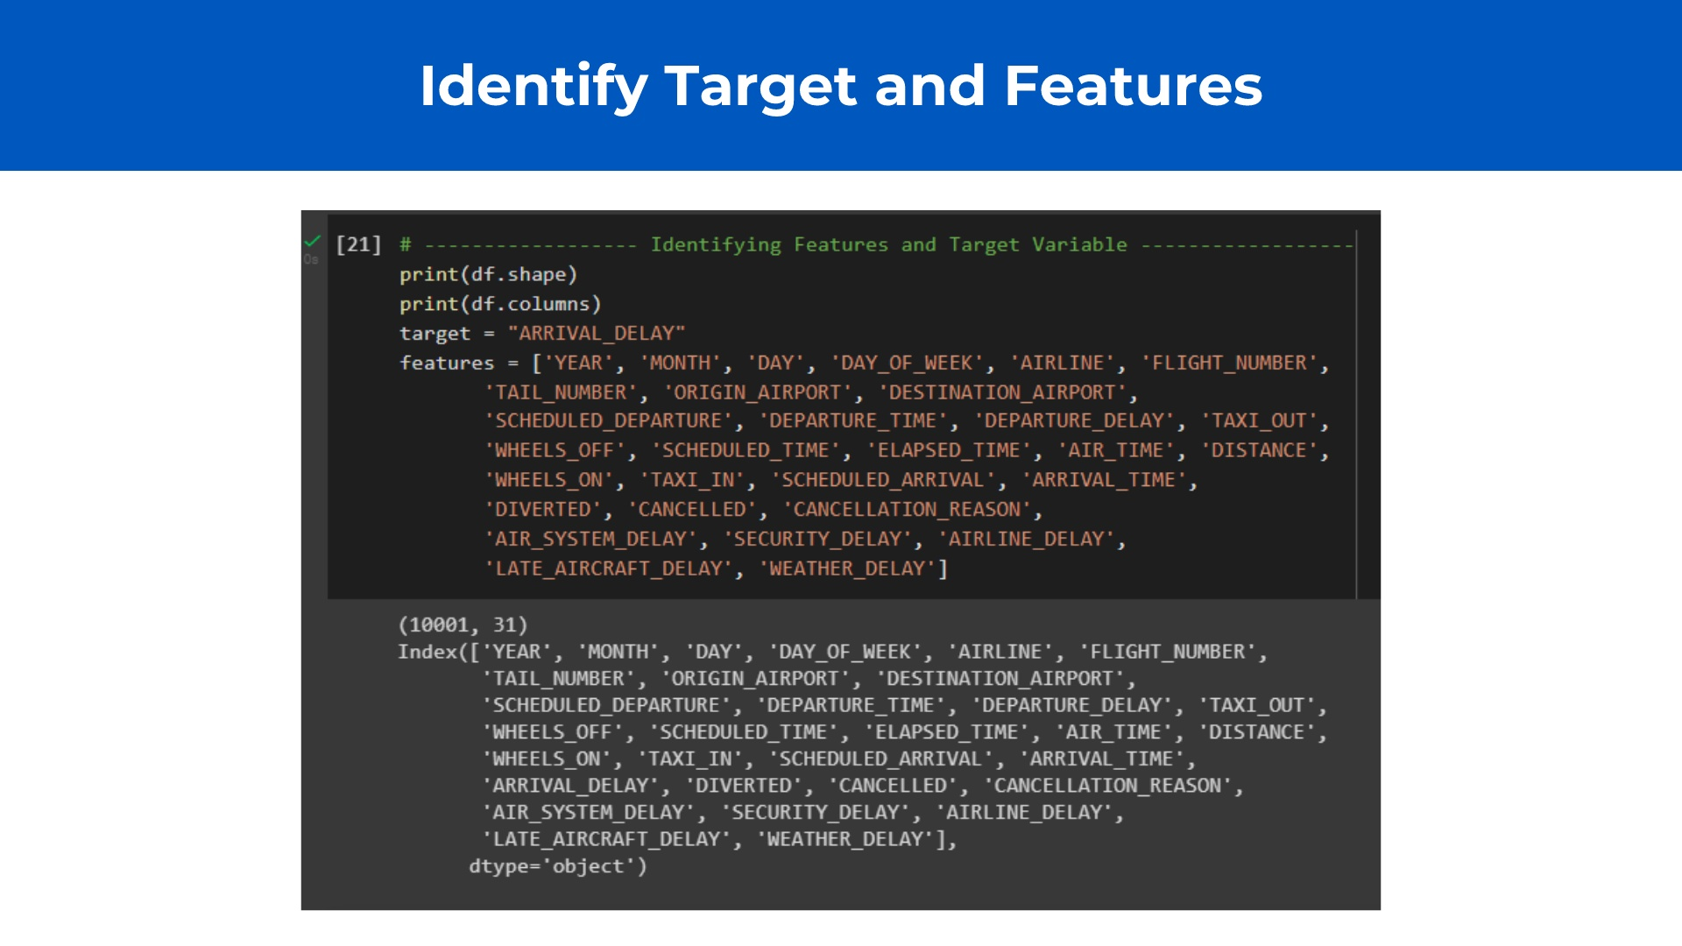
Notes:
Assign place in memory for Target and Features Features is an array, mathematically, a one dimensional vector

Slide 11
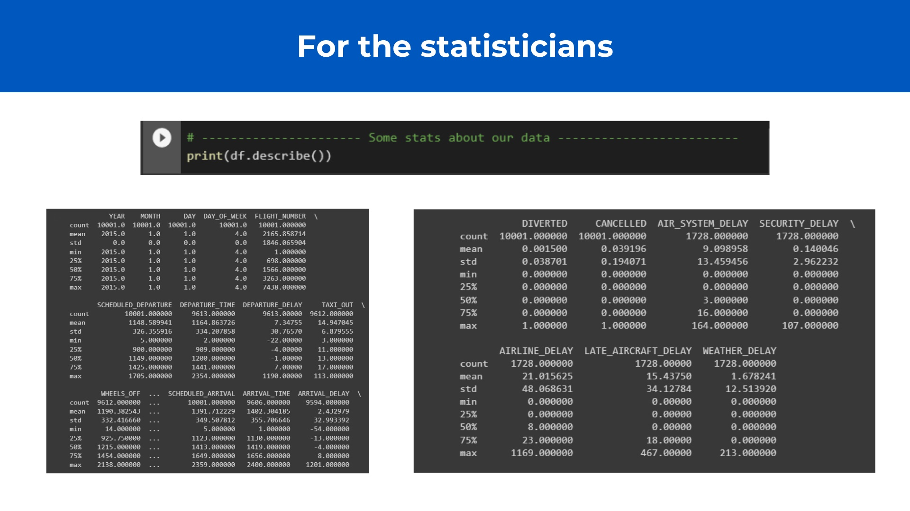
Notes:
May seem useless but these stats usually give some insight into our dataset

Slide 12
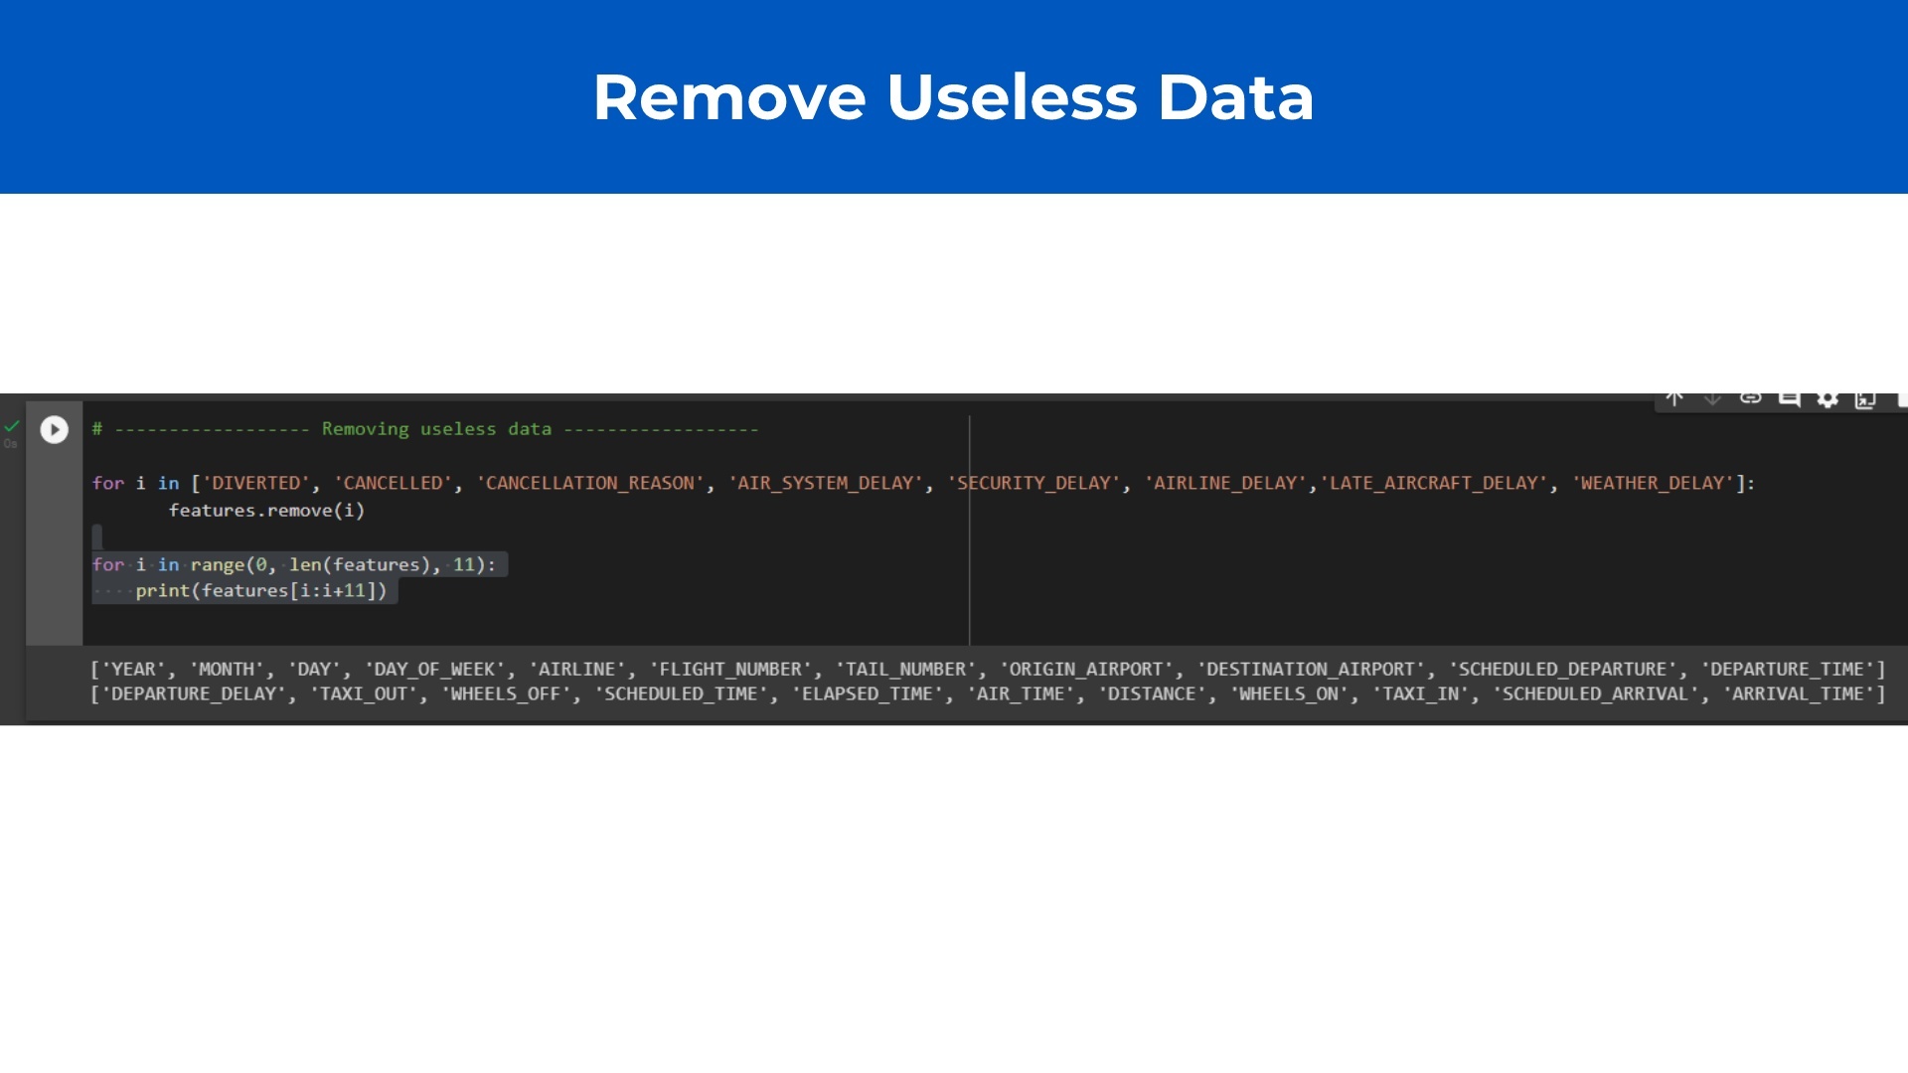
Notes:
Iterate over a separate list to avoid collisions and bugs Print features to check what remains For loop used for print to have two separate lines. Not necessary

Slide 13
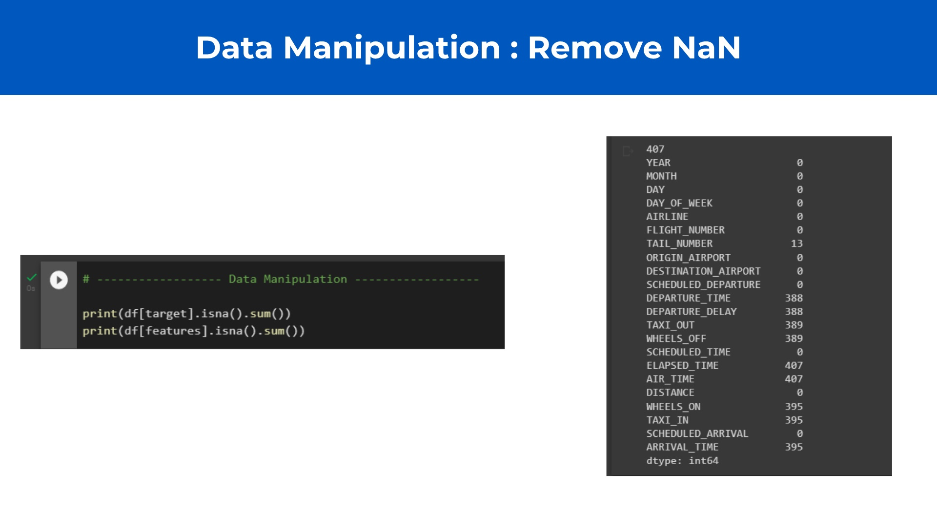
Notes:
1. check for NaN values in Feature and Target dataframes 2. Do this by calling the sum of all NaN values Notice that we have same number of Target NaNs as we do with Features

Slide 14
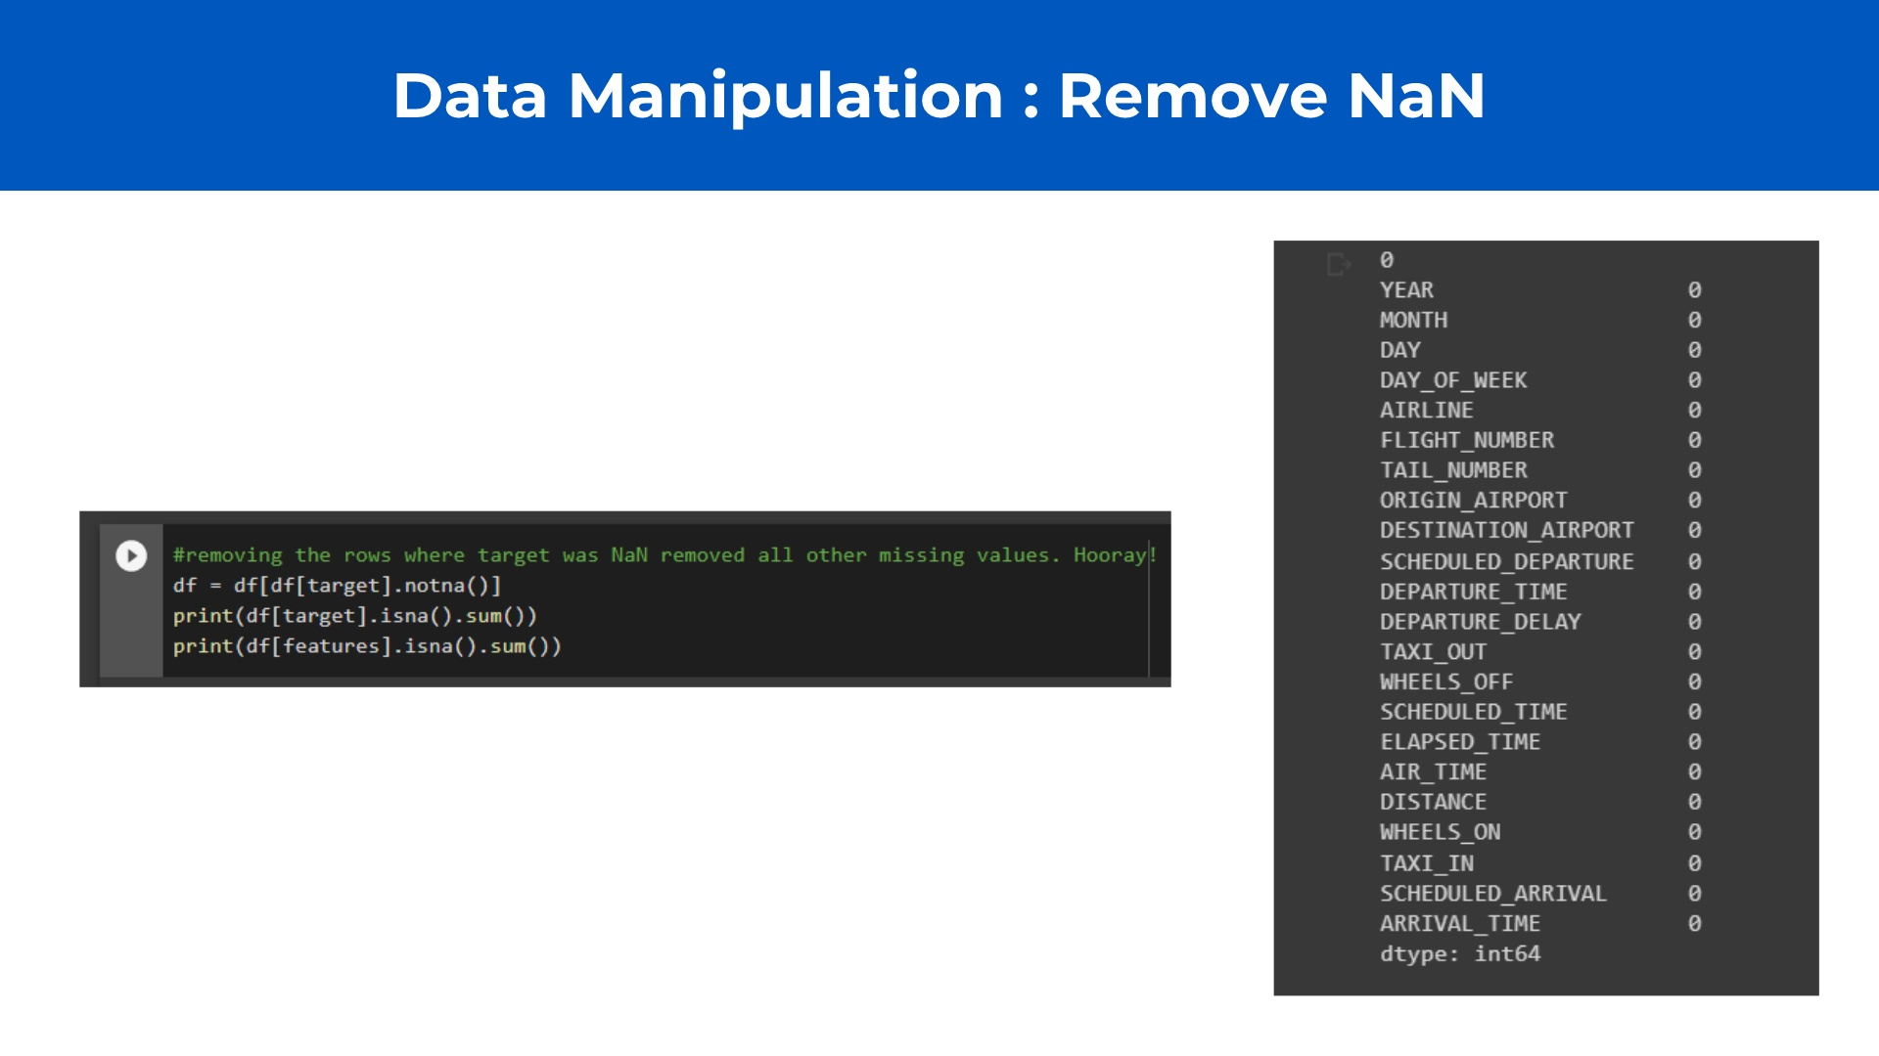

Slide 15
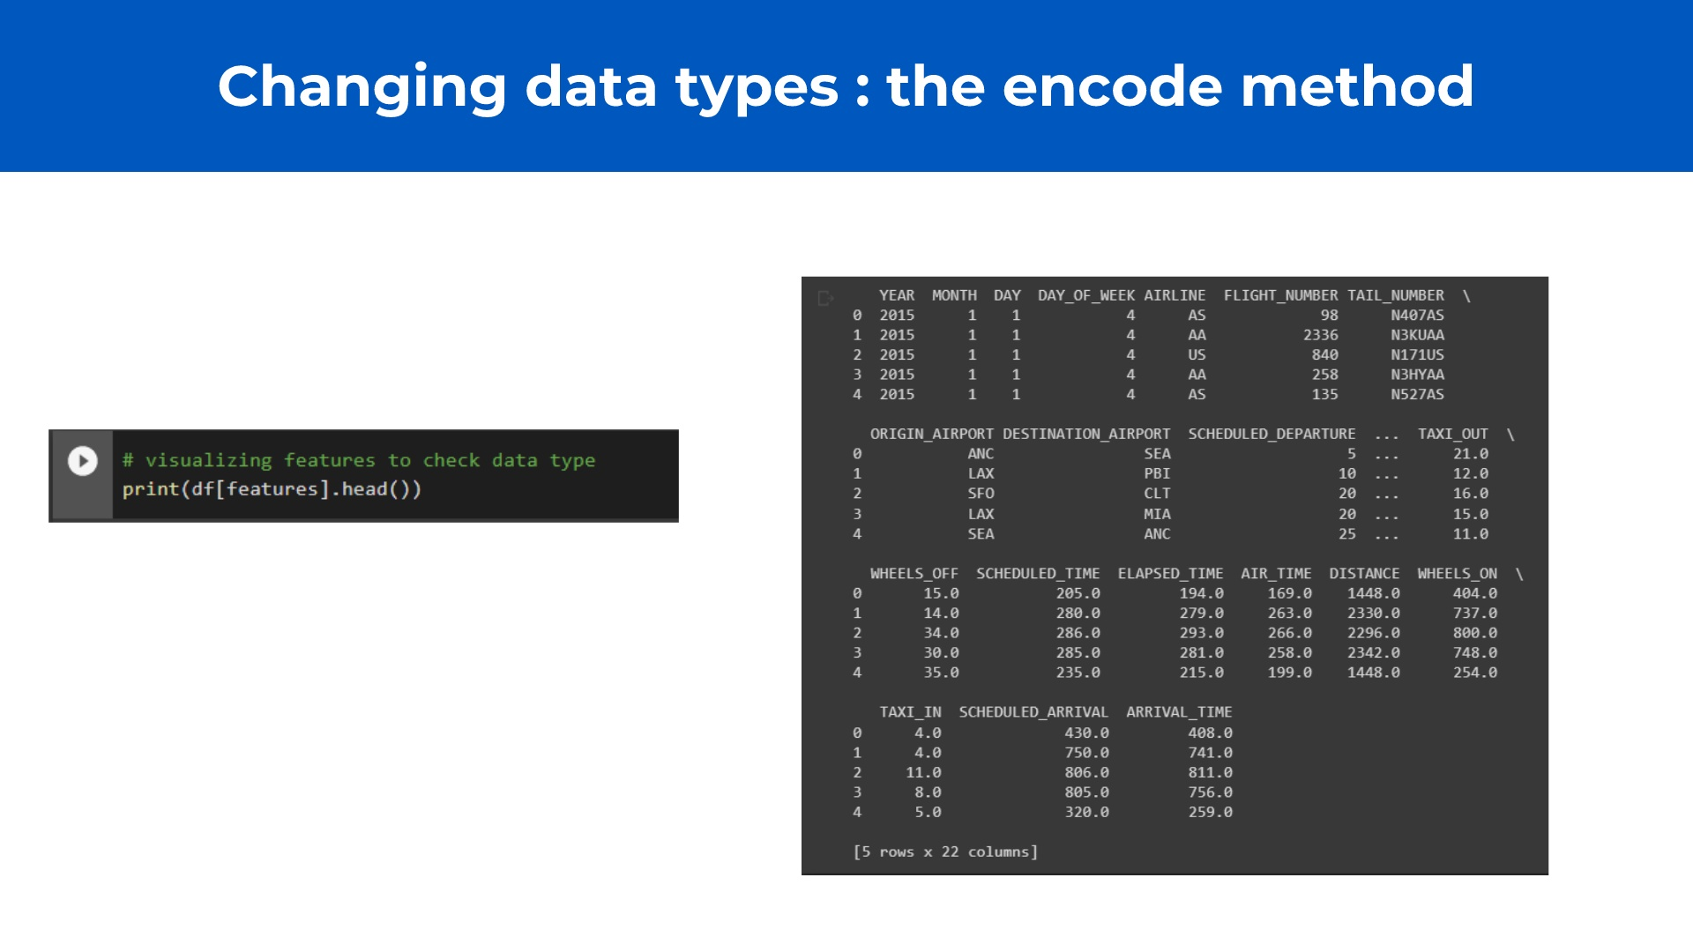
Notes:
Tail Number and IATA codes are not viable for the model. So we use an encoder Encoder works like a hashmap: assigns a key for every value

Slide 16
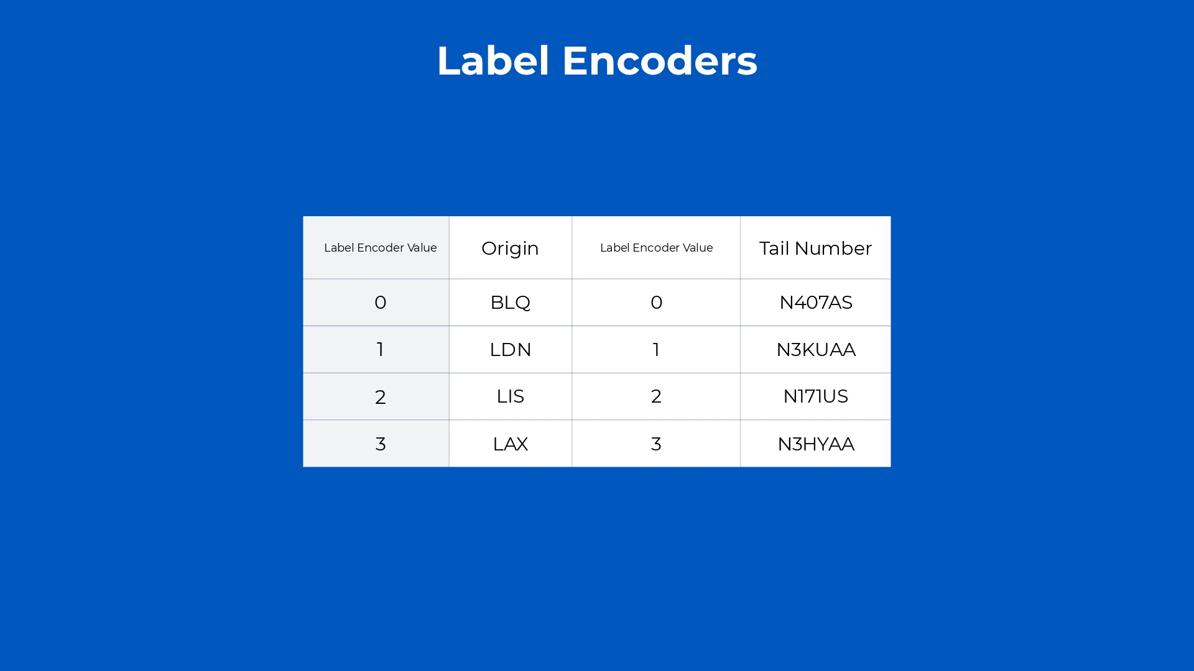
Notes:
We generate ONE LabelEncoder Object per Feature Each feature has assigned to it a specific encoder

Slide 17
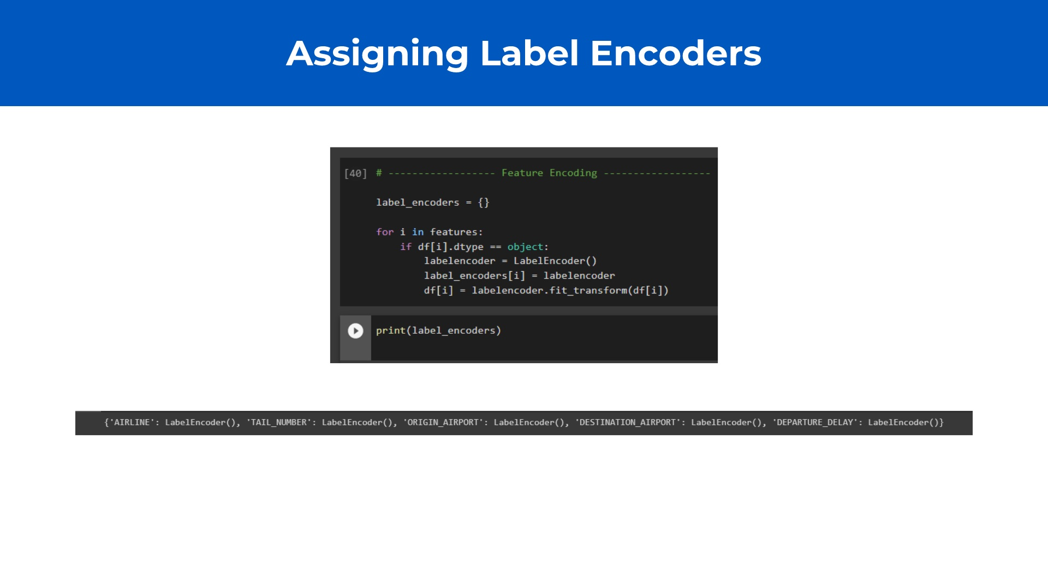
Notes:
Tail Number and IATA codes are not viable for the model. So we use an encoder Encoder works like a hashmap: assigns a key for every value

Slide 18


Slide 19
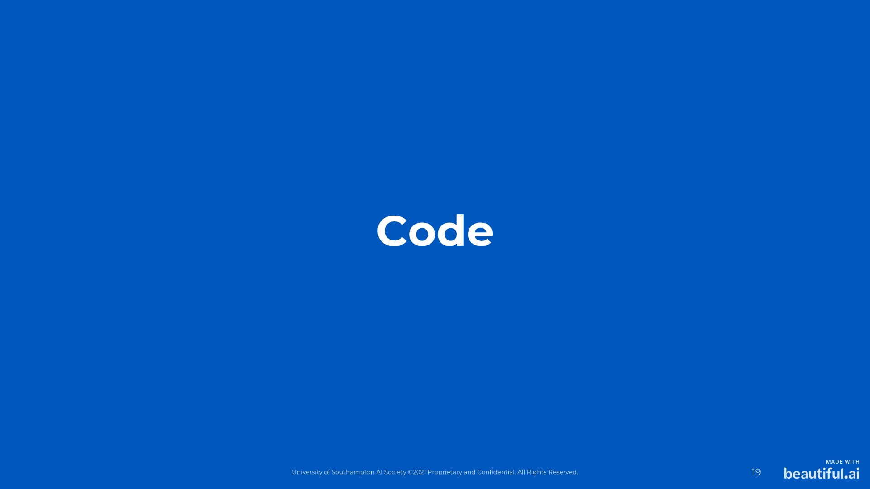

Slide 20
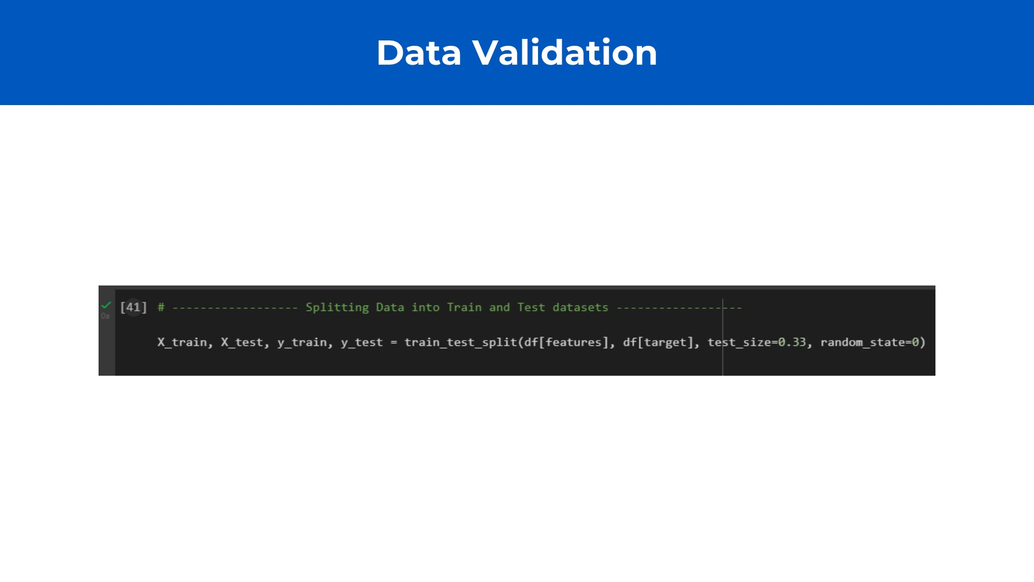
Notes:
Tail Number and IATA codes are not viable for the model. So we use an encoder Encoder works like a hashmap: assigns a key for every value

Slide 21
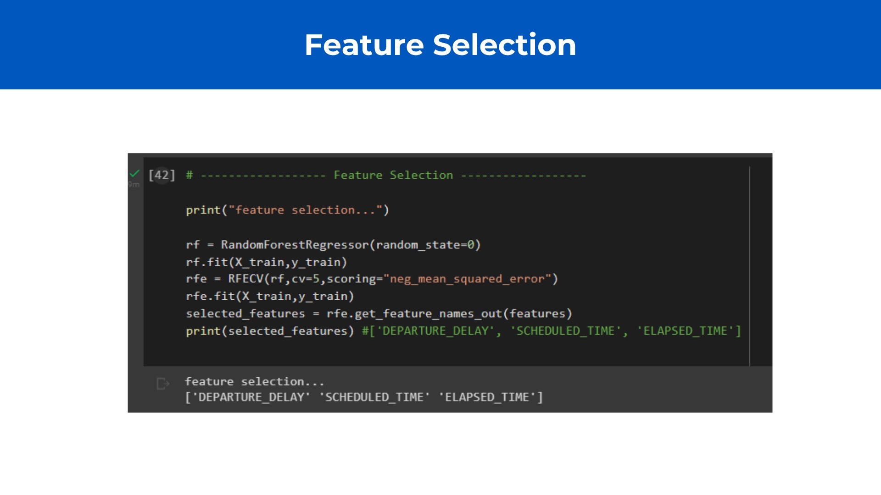
Notes:
Tail Number and IATA codes are not viable for the model. So we use an encoder Encoder works like a hashmap: assigns a key for every value

Slide 22
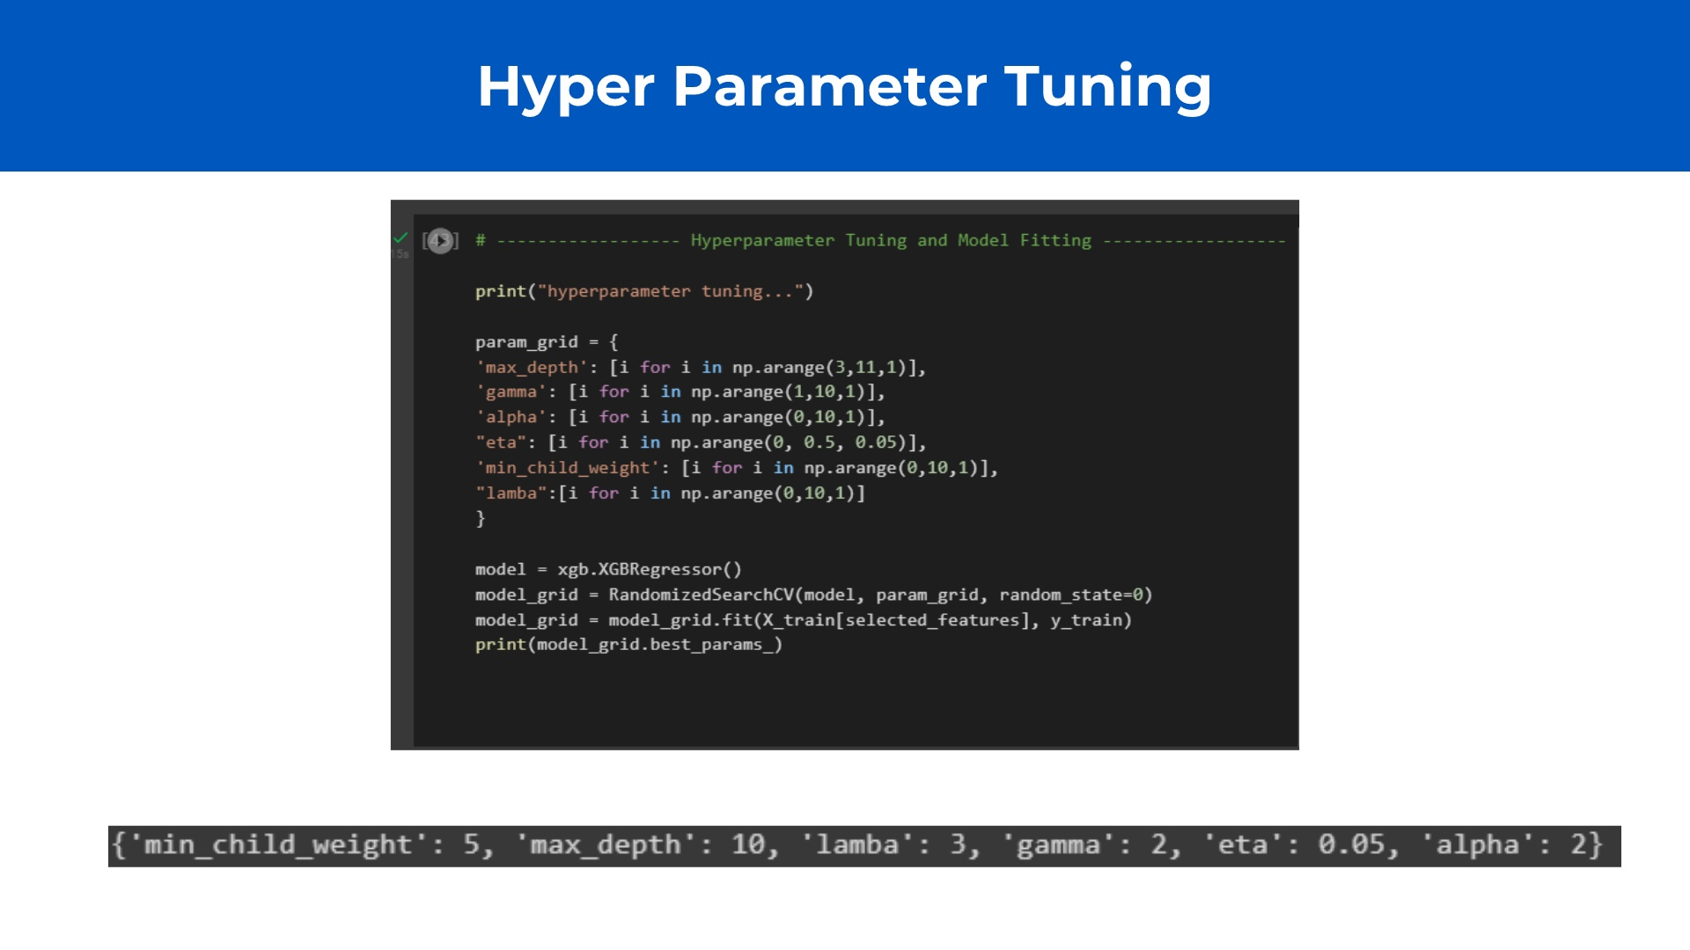
Notes:
Tail Number and IATA codes are not viable for the model. So we use an encoder Encoder works like a hashmap: assigns a key for every value

Slide 23
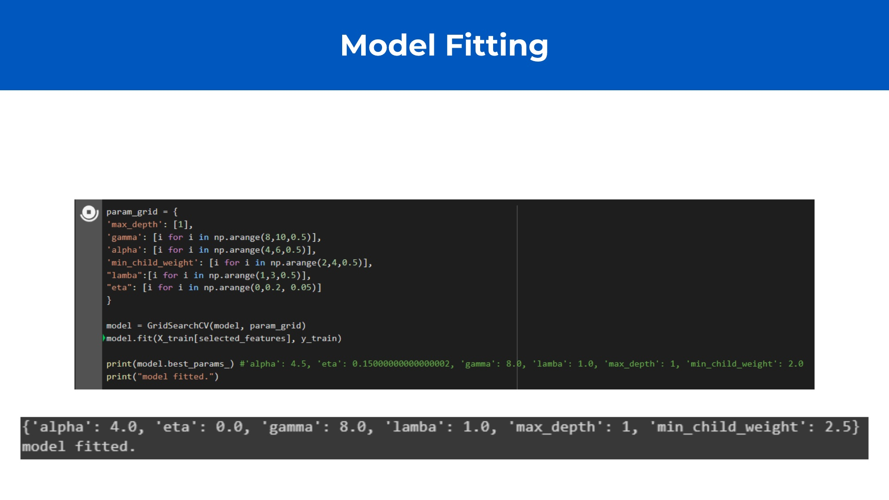
Notes:
Assume +-1 for values outputted by Parameter Tuning Iterate, for each of them, with a difference of 0.5. Means building a model and testing it for every variable Output is model with best accuracy

Slide 24
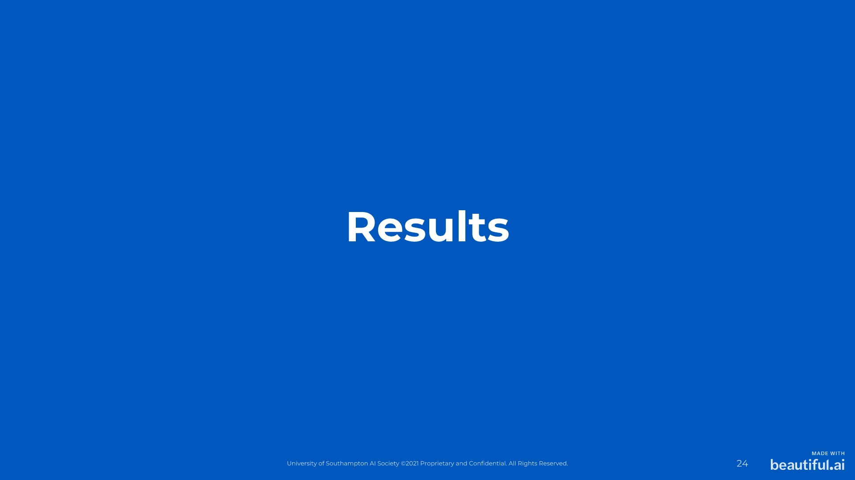
Notes:
Show test results, how to improve and the decision tree itself + explain the evaluation methods

Slide 25
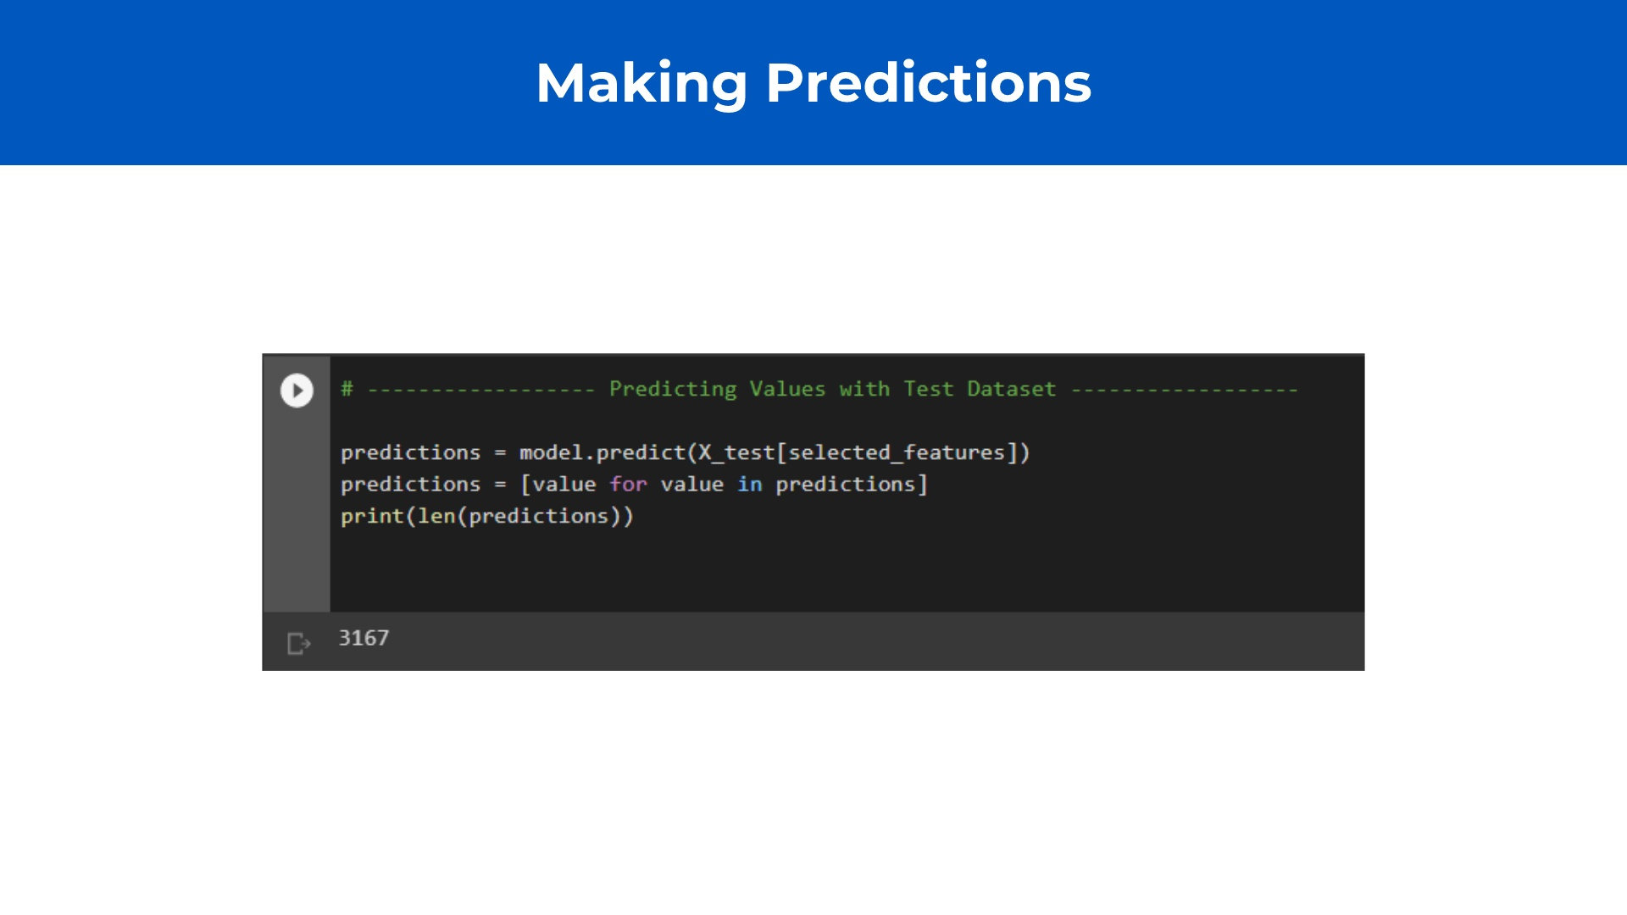
Notes:
Assume +-1 for values outputted by Parameter Tuning Iterate, for each of them, with a difference of 0.5. Means building a model and testing it for every variable Output is model with best accuracy

Slide 26
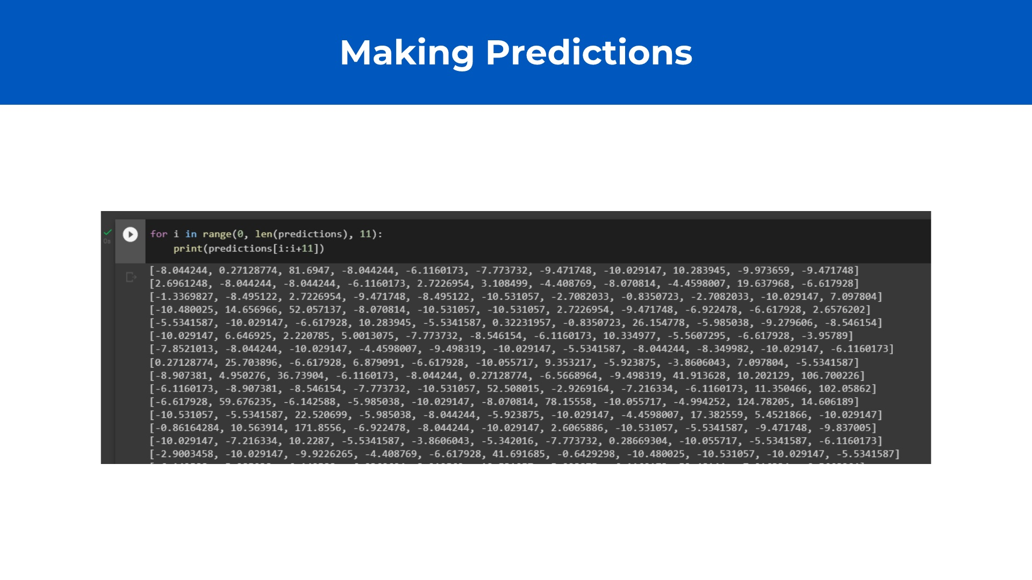

Slide 27
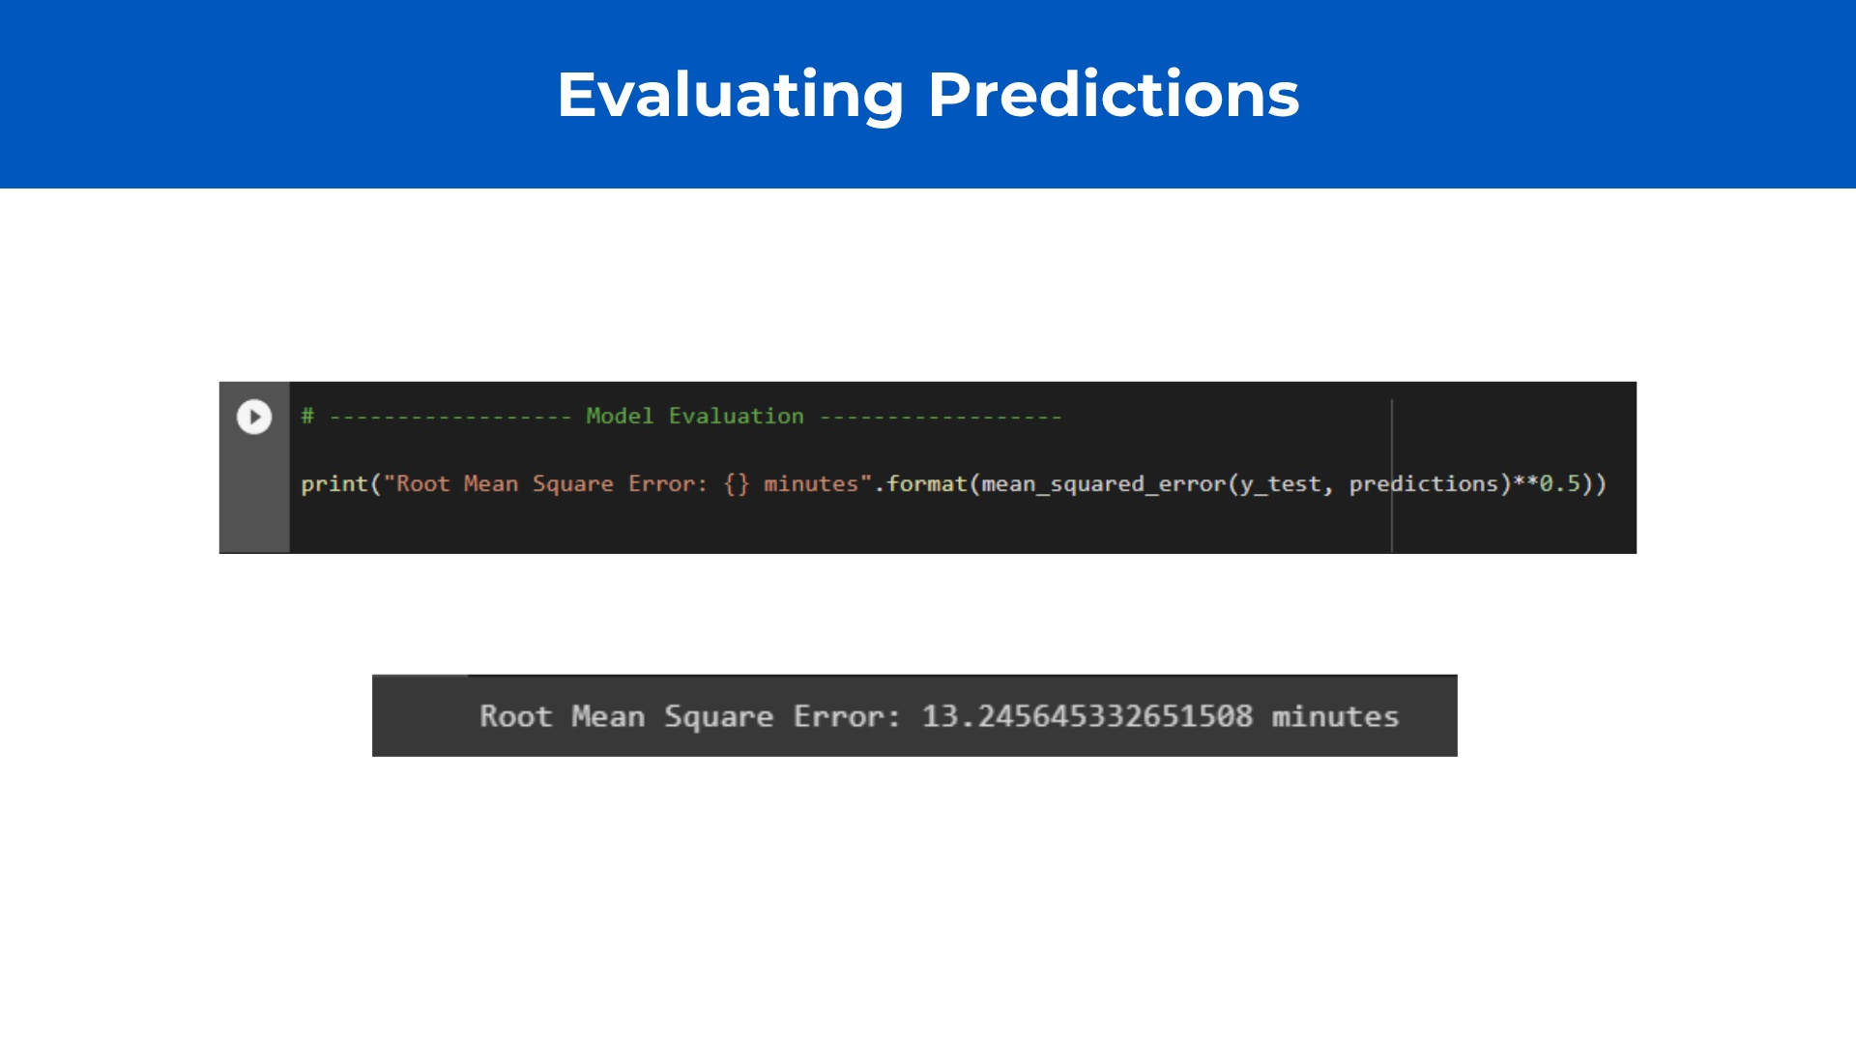
Notes:
Assume +-1 for values outputted by Parameter Tuning Iterate, for each of them, with a difference of 0.5. Means building a model and testing it for every variable Output is model with best accuracy

Slide 28


Slide 29

Notes:
Check who won the previous challenge and announce at the beginning of the workshop no need to encode variables: https://www.kaggle.com/datasets/prathamtripathi/drug-classification show how to submit on kaggle

